Slide 1
Exception handling

Slide 2
Exceptions and Errors
Class Throwable
Exceptions types
Handling exceptions
Assertions

Slide 3
Exceptions and Errors
Errors and Exceptions represent problems that arise during the execution of a program. They can occur for many different reasons, for example:
failure of an input/output operation
a user has entered invalid data
a file that needs to be opened cannot be found
a network connection has been lost in the middle of communications or the JVM has run out of memory
inability to cast from one type to another
printing failed
Exceptions are situations that might appear frequently and, usually, the ,problems that appeared can be repaired.
Errors are problems that arise beyond the control of the user or the programmer. Errors are typically ignored in your code because we can rarely do anything about an error. For example, if a stack overflow occurs, an error will arise.

Slide 4
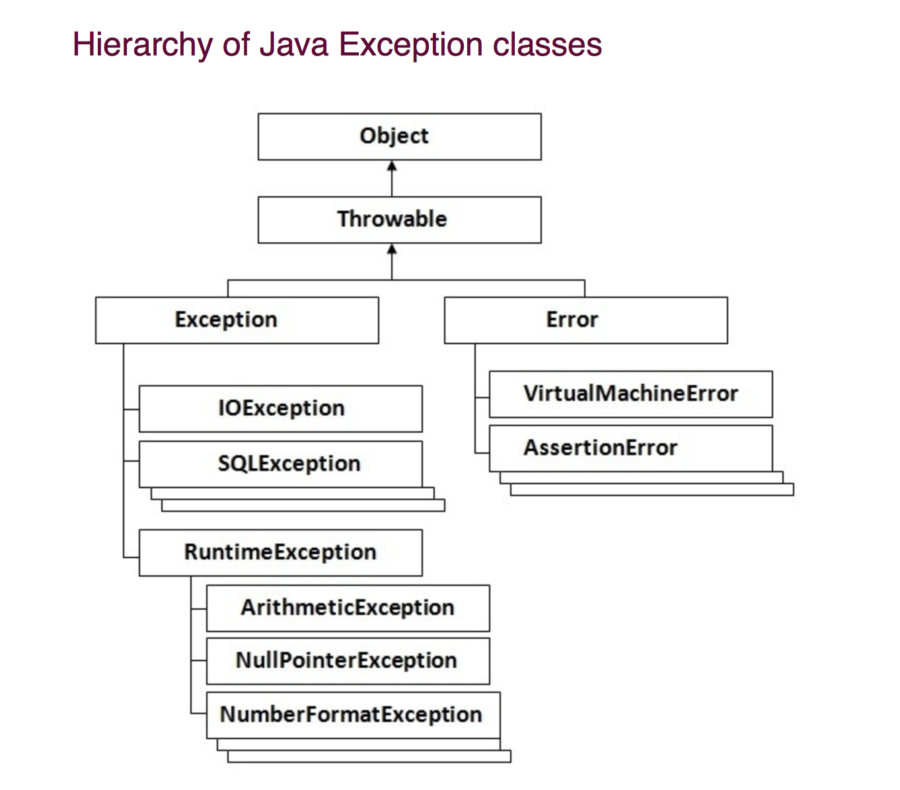

Slide 5
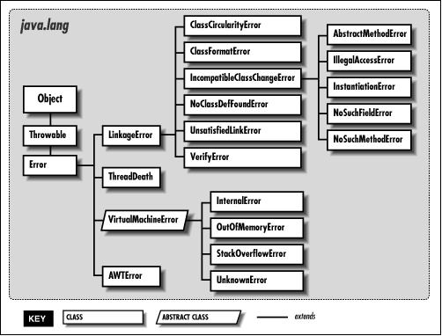
Exceptions and Errors

Slide 6
Exceptions types
To understand how exception handling works in Java, we need to understand different exception types:
Checked exceptions – a checked exception is an exception that is typically a user error or a problem that cannot be foreseen by the programmer by the programmer. For example, if a file is to be opened, but the file cannot be found, an exception occurs. These exceptions cannot simply be ignored at the time of compilation
Runtime exceptions – a runtime exception is an exception that occurs that probably could have been avoided by the programmer. As opposed to checked exceptions, runtime exceptions are ignored at the time of compilation

Slide 7
Handling Exceptions
Java being an object oriented programming language, whenever an exception occurs while executing a statement, creates an exception object and then the normal flow of the program halts and JRE tries to find someone that can handle the raised exception. The exception object contains a lot of debugging information such as method hierarchy, line number where the exception occurred, type of exception etc. When the exception occurs in a method, the process of creating the exception object and handing it over to runtime environment is called throwing the exception.
The core advantage of exception handling is to maintain the normal flow of the application.
public class Testtrycatch1{
public static void main(String args[]){
int data=50/0;//may throw exception
System.out.println("rest of the code...");
}
}
public class Testtrycatch2{
public static void main(String args[]){
try{
int data=50/0;
}catch(ArithmeticException e){System.out.println(e);}
System.out.println("rest of the code...");
}
}

Slide 8
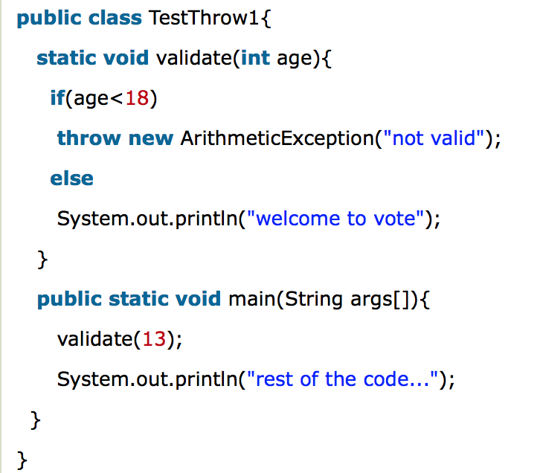
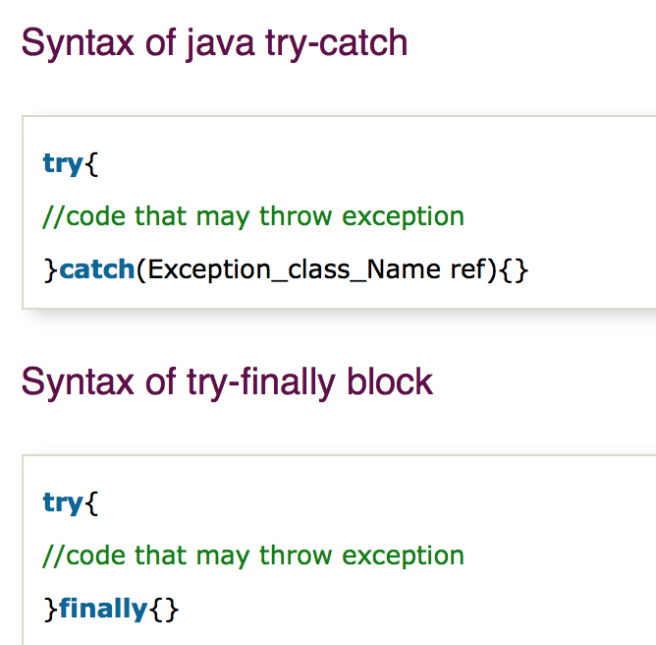
How To Exception?
There are 5 key words for exception handling:
TRY
CATCH
FINALLY
THROW
THROWS
* Many catches

Slide 9
Class Throwable
The Throwable class is the superclass of all errors and exceptions in the Java language. Only objects that are instances of this class (or one of its subclasses) are thrown by the Java Virtual Machine or can be thrown by the Java throw statement. Similarly, only this class or one of its subclasses can be the argument type in a catch clause.
Method Summary
Method prototype | Method description
public Throwable getCause () | Returns the cause of this throwable or null if the cause is nonexistent or unknown
String getMessage () | Returns the detail message string of this throwable
Throwable initCause (Throwable cause) | Initializes the cause of this throwable to the specified value
void printStackTrace () | This method prints a stack trace for this Throwable object on the error output stream that is the value of the field System.err
void printStackTrace (PrintStream s) | Prints this throwable and its backtrace to the specified print stream
void printStackTrace (PrintWriter s) | Prints this throwable and its backtrace to the specified print writer

Slide 10
Assertions
An assertion is a statement in Java that enables us to test our assumptions about our program. Assertion offers several benefits:
Assertion is great for data validation. We can use Java assert keyword to validate data passed to method, classic example is method which calculates interest rates; we know that amount and time can not be less than zero and by using assert keyword in java we can validate this data at runtime and if by any chance our function is getting incorrect data our program will fail with AssertionError.
Assertion in Java guarantees that at certain point on function our assumption or certain condition is true otherwise it would not have come to that point and would have been terminated with AssertionError, this makes debugging in Java a lot easier
Using Java assert keyword helps to detect bug early in development cycle which is very cost effective. It also makes debugging easier, because AssertionError clearly tells source and reason of error.
Writing code with assert statement will help us to be better programmer and improve quality of code. This is true because when we write code using assert statement we think about possible input to a function, we think about boundary condition which eventually result in better discipline and quality code.

Slide 11
Assertions
assert keyword is used to implement assertion in Java. We can use assert keyword in two format:
assert booleanExpresion;
assert booleanExpresion : errorMessage
As shown above assert keyword in java has two forms. First form assert booleanExpression is used to test the boolean expression and if boolean expression is false then Java throws AssertionError and our program terminates. Second form of assert keyword assert booleanExpression : errorMessage is more useful and provides a mechanism to pass additional data when Java assertion fails and Java throws AssertionError.

Slide 12


Iunona Panasenco
AM Engineer
iunona.panasenco@endava.com
079877558

